Slide 1
Reinforcement Learning –
Learning from Interaction
Thanks to Alan Fern, Tom Dietterich and Xiaoli Fern

Slide 2
Learning to Control
So far looked at two models of supervised learning
  Supervised:
    Classification,
    Regression, etc.
Alternative: No labels – Unsupervised learning, Clustering, etc.
How did you learn to ride a bicycle?
  Neither of the above
  Trial and error!
  Falling down hurts!
Intro to RL

Slide 3
3 Learning Formalisms
Learning algorithms can be classified based on the three types of feedback that the learner has access to:
Supervised Learning: One extreme → For every input, the learner is provided with a target. The environment tells the learner what its response is. The learner then compares its actual response to the target and adjusts its internal memory in such a way that it is more likely to produce the appropriate response the next time it receives the same input.
Unsupervised Learning: On the other extreme → The learner receives no feedback from the world at all. Instead the learner's task is to re-represent the inputs in a more efficient way, as clusters or categories or using a reduced set of dimensions. Unsupervised learning is based on the similarities and differences among the input patterns. It does not result directly in differences in overt behavior because its "outputs" are really internal representations.

Slide 4
3 Learning Formalisms
3. Reinforcement Learning: A third alternative, much closer to supervised than unsupervised learning → The learner receives feedback about the appropriateness of its response. For correct responses, RL resembles supervised learning: in both cases, the learner receives information that what it did is appropriate. However, the two forms of learning differ significantly for errors.
Supervised learning lets the learner know exactly what it should have done.
Reinforcement Learning only says that the behavior was inappropriate and (usually) how inappropriate it was.

Slide 5
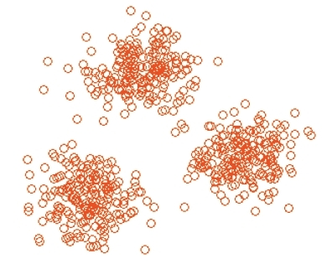
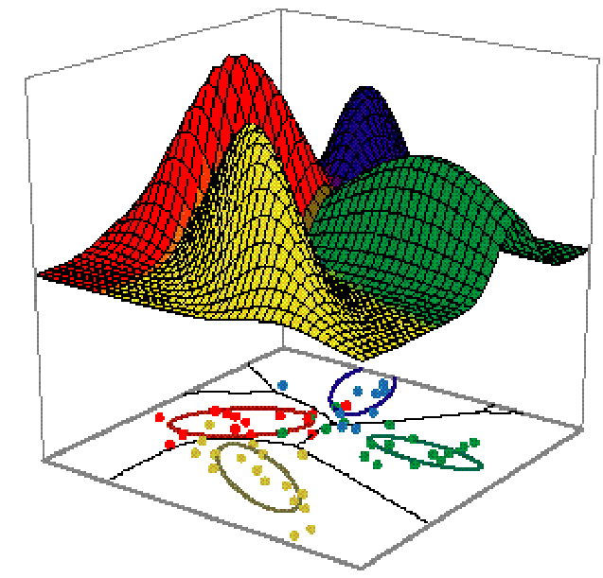
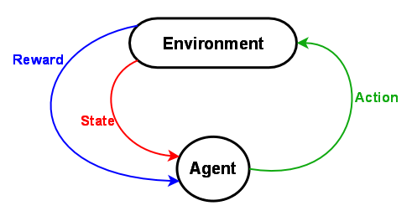
3 Learning Formalisms

Slide 6
Reinforcement Learning
Consider learning to choose actions, like:
  Robot learning to dock on battery charger
  Learning to choose actions to optimize factory output
  Learning to play Backgammon
Note several problem characteristics:
  Delayed reward
  Opportunity for active exploration
  Possibility that state only partially observable
  Possible need to learn multiple tasks with same sensors/effector
  Probabilistic Action Outcomes

Slide 7

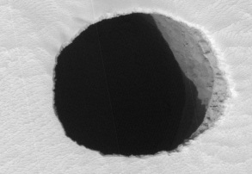

Example domain

Slide 8
Example domain
Actions
Effects
0.6
0.4
1.0
0.6
0.4
1.0

Slide 9
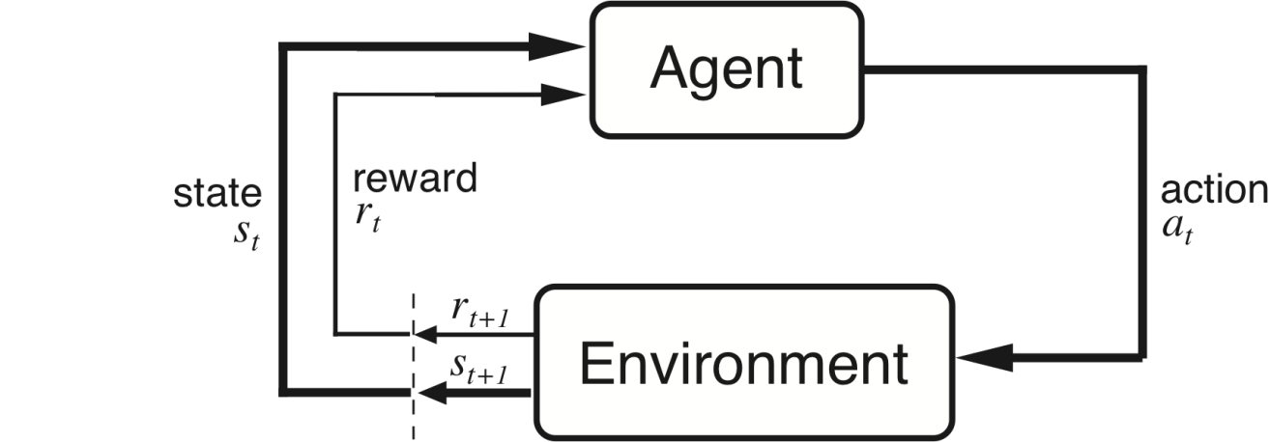
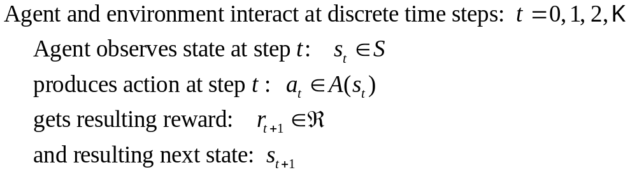
The Agent-Environment Interface
. . .
r
t +1
r
t +2
r
. . .
s
s
t +1
s
t +2
t +3
s
t +3
t
a
a
t +1
a
t +2
a
t
t +3

Slide 10

What does the agent learn?
Straight line plan:
a₁, a₂, a₃, …..
No guarantee! The actions have probabilistic effects. For example, when picking up an object, there is a non-zero chance of dropping it.
Policy:
Map from states to actions.
Agent tries to learn the optimal policy. But optimal in terms of what?
Intro to RL

Slide 11

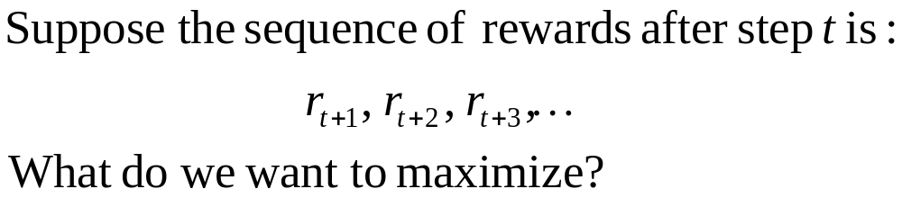

Returns
Episodic tasks: interaction breaks naturally into episodes, e.g., plays of a game, trips through a maze.
where T is a final time step at which a terminal state is reached, ending an episode.
Non-Episodic tasks: No episodes. Infinite game. e.g. a fire engine trying putting out fires as they arise.
Intro to RL

Slide 12
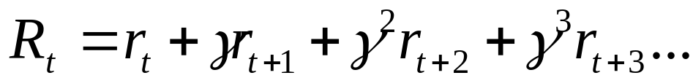


Returns
Finite Horizon: Fixed T
Infinite Horizon: T is infinite
Problem: All policies have infinite returns.
Solution: Discounted reward
Optimality Criterion: Find that maximizes
Note that the goal has changed from maximizing reward to expected reward
Intro to RL

Slide 13



Example domain - Rewards
Example – Reward 1
-1 for every step taken
+10 for reaching the goal
-50 for falling in the pit
Example – Reward 2
0 for every step taken
+10 for reaching the goal
-50 for falling in the pit
What is the difference in optimal policy between Reward 1 scheme and
Reward 2 scheme?

Slide 14
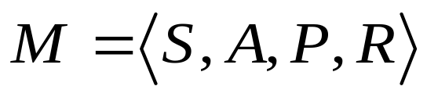
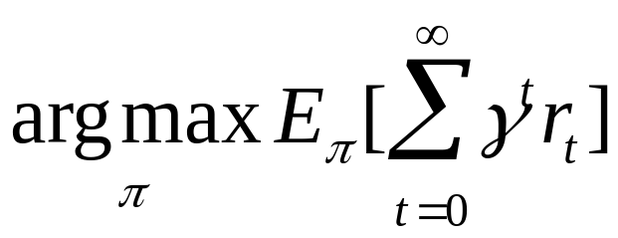
Markov Decision Process
S: Set of fully observable states
A: Set of actions available to the agent
P: Probabilistic state transition function P(s’|s,a) describing the probability of reaching state s’ if the agent takes action a in state s.
R: Reward function R(s) describing the immediate reward the agent achieves for being in a state.
Goal: Find that maximizes the total expected discounted reward
Intro to RL

Slide 15
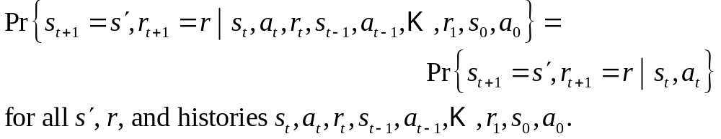
The Markov Property
“the state” at step t, means whatever information is available to the agent at step t about its environment. – Snapshot of the world
The state can include immediate “sensations”, highly processed sensations, and structures built up over time from sequences of sensations.
Ideally, a state should summarize past sensations so as to retain all “essential” information, i.e., it should have the Markov Property:
Intro to RL

Slide 16
Example domain
Actions
Effects
0.6
0.4
1.0
0.6
0.4
1.0

Slide 17
Example domain
Actions
Effects
+10
0.6
0.4
-50
1.0
0.6
0.4
1.0

Slide 18
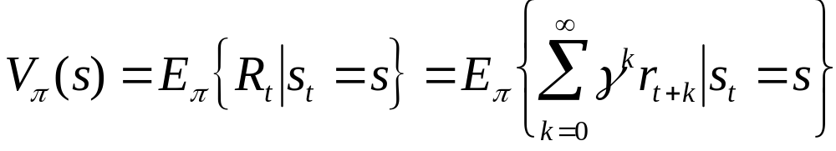
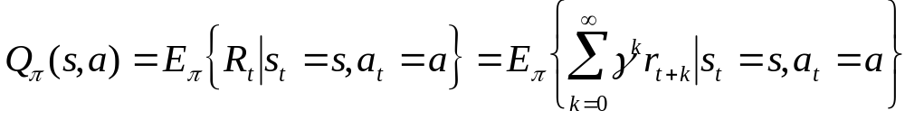
Value Functions
The value of a state is the expected return starting from that state; depends on the agent’s policy:
Informally the value of a state indicates how much better it is to be in that state than other states, when following the policy
The value of a state-action pair is the expected return starting from that state, taking that action, and thereafter following π :
State value function for policy
State-action value function for policy
Intro to RL

Slide 19

Example domain – Values
Which of the states will have a higher value? S1 or S2?
Which action will have a higher value in S1? or ?
Which action will have a higher value in S2? or ?
 |  | S1
S2

Slide 20
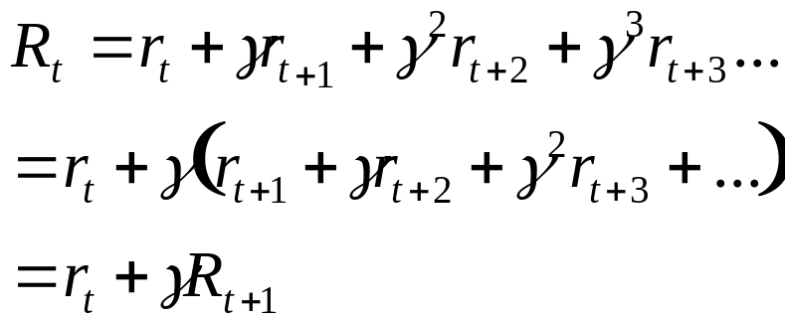
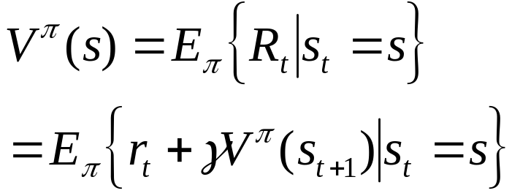
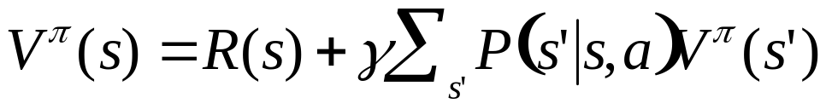
Bellman Equation for a Policy π
The basic idea:
So:
Or, without the expectation operator:
Intro to RL

Slide 21
Example domain
What is the value of this policy?
Actions
Effects
0.6
0.4
1.0
0.6
0.4
1.0

Slide 22
Example domain
What is the value of this policy?
Actions
Effects
0
-45
0
10
0.6
0.4
0
-50
0
0
1.0
0
0
0
0
0.6
0.4
0
0
1.0
0
0
0
0

Slide 23
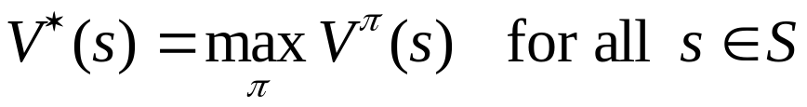
Optimal Value Functions
For finite MDPs, policies can be partially ordered:
There is always at least one (and possibly many) policies that is better than or equal to all the others. This is an optimal policy. We denote them all π *.
Optimal policies share the same optimal state-value function:
Intro to RL

Slide 24
Example domain – One optimal policy
Actions
Effects
0.6
0.4
1.0
0.6
0.4
1.0
We will see more policies later.In our homework, you will learn the optimal policy for this domain

Slide 25
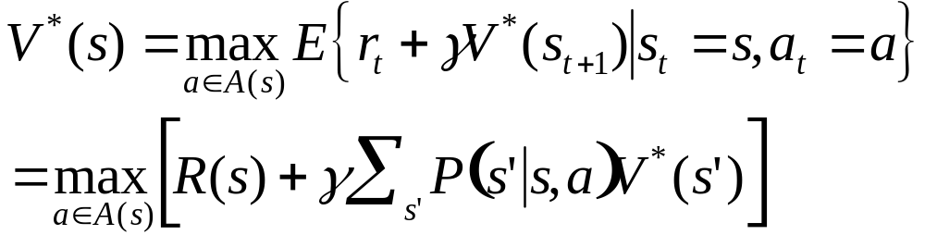

Bellman Optimality Equation
The value of a state under an optimal policy must equal
the expected return for the best action from that state:
is the unique solution of this system of nonlinear equations.
Intro to RL

Slide 26
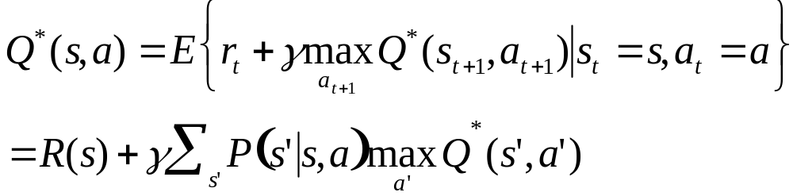

Bellman Optimality Equation
Similarly, the optimal value of a state-action pair is the
expected return for taking that action and thereafter
following the optimal policy
is the unique solution of this system of nonlinear equations.
Intro to RL

Slide 27
Dynamic Programming
DP is the solution method of choice for MDPs
  Require complete knowledge of system dynamics (P and R)
  Expensive and often not practical
  Curse of dimensionality
  Guaranteed to converge!
RL methods: online approximate dynamic programming
  No knowledge of P and R
  Sample trajectories through state space
  Some theoretical convergence analysis available
Intro to RL

Slide 28

Policy Evaluation
Policy Evaluation: for a given policy π, compute the
state-value function
Recall:
State value function:
Bellman Equation:
-System of |S| simultaneous linear equations
-Solve iteratively
Intro to RL

Slide 29


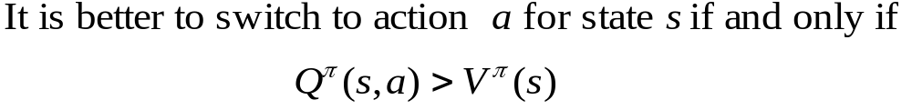
Policy Improvement
Suppose we have computed for a policy π.
For a given state s, would it be better to do an action ?
The value of performing action a in state s is:
Intro to RL

Slide 30
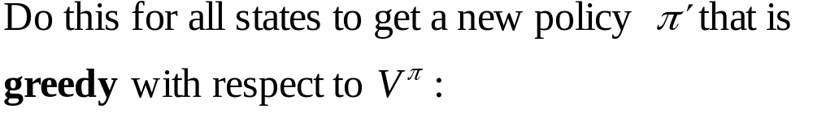



Policy Improvement Cont.
Stop when
Then
Intro to RL

Slide 31
Policy Iteration
policy evaluation
policy improvement
“greedification”
Intro to RL

Slide 32
Example domain
What is the value of this policy?
Actions
Effects
0.6
0.4
1.0
0.6
0.4
1.0

Slide 33
Example domain
What is the value of this policy?
Actions
Effects
0
-45
0
10
0.6
0.4
0
-50
0
0
1.0
0
0
0
0
0.6
0.4
0
0
1.0
0
0
0
0

Slide 34
Example domain – Improved policy
Actions
Effects
0.6
0.4
1.0
0.6
0.4
1.0

Slide 35
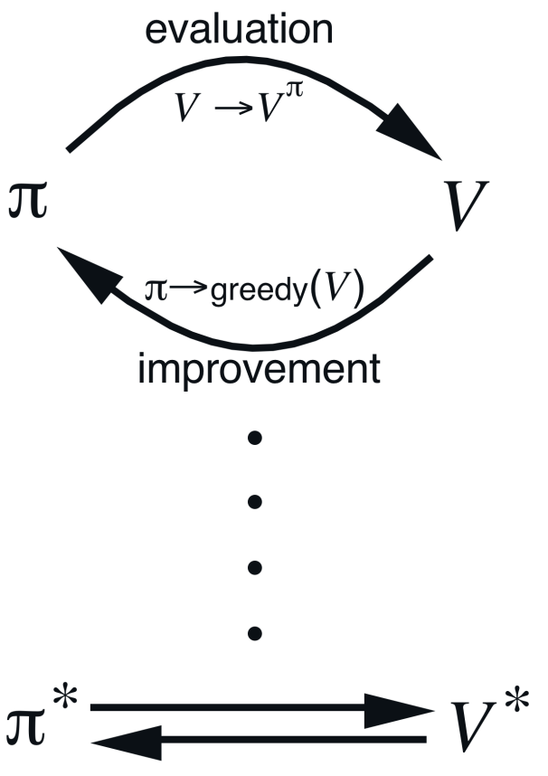
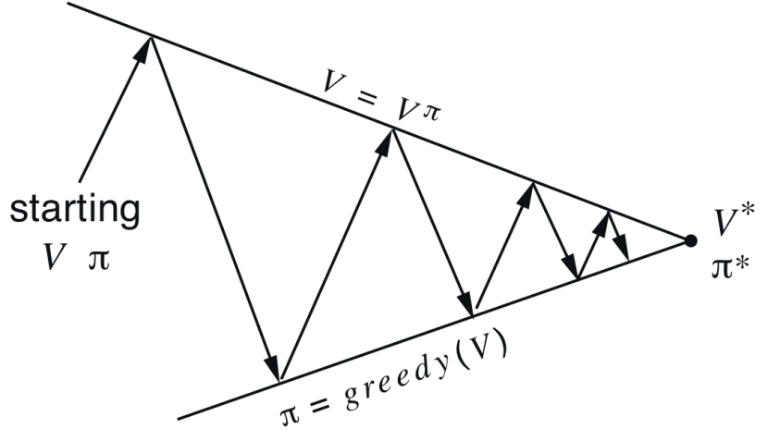
Generalized Policy Iteration
Generalized Policy Iteration (GPI):
any interaction of policy evaluation and policy improvement,
independent of their granularity.
A geometric metaphor for
convergence of GPI:
Intro to RL

Slide 36
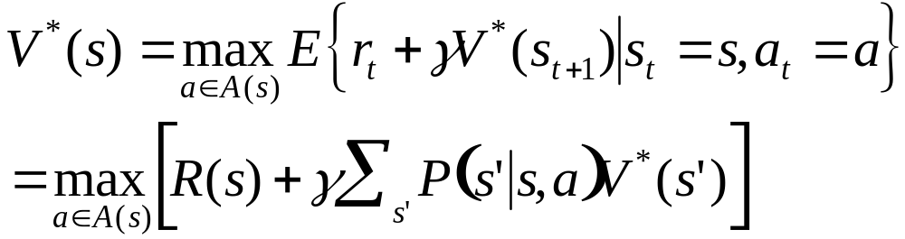
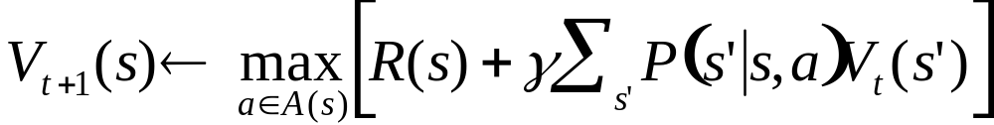
Value Iteration
Recall the Bellman optimality equation:
We can convert it to an full value iteration backup:
Iterate until “convergence”
Intro to RL

Slide 37
Example domain
Optimal Value Function: Value of the optimal policy
Actions
Effects
11.33
10.16
37.73
51.18
0.6
0.4
12.64
-28.24
28.16
37.73
1.0
14.09
18.29
21.79
28.16
0.6
0.4
11.82
18.29
1.0
9.91
11.82
14.09
12.64

Slide 38
Example domain – Optimal policy
Actions
Effects
0.6
0.4
1.0
0.6
0.4
1.0

